Slide 1
PYTHON
FUNCTIONS(MODULES IN BUILD FUNCTIONS ,LAMBDA ,DECORATOR GENERATOR)

Slide 2
BUILT-IN FUNCTIONS
Built-in functions are the pre-defined functions in python that allows using the basic properties of strings and numbers .
There are 60+ built-in functions in Python .
The top 10 built-in functions are abs,chr,dict,enumerate ,min-max,float, len,list,range and set.

Slide 3
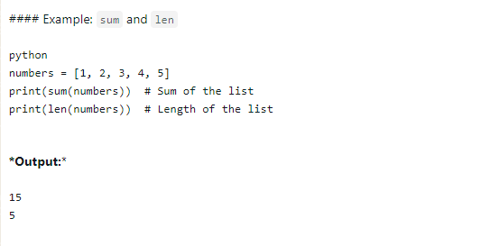
Here are some few examples of built-in function
Sum and length :
Purpose: sum returns the sum of all items in an iterable.
Purpose:Length returns the number of items in an object (like a list,string ,or tuple)
Example:

Slide 4
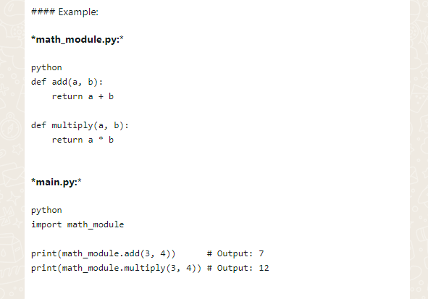
USING MODULES
Python allows you to organize your code into modules ,which are just Python files.You can import these modules using the import statement.
Example:

Slide 5
FUNCTIONS
A function is a block of code which only runs when it is called.
You can pass data, known as parameters, into a function.
A function can return data as a result.

Slide 6
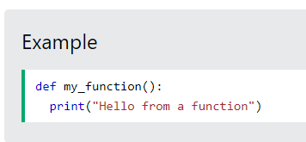
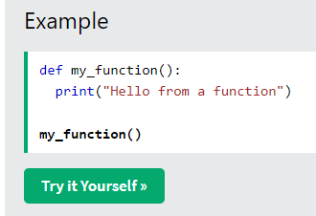
CREATING AND CALLING A FUNCTION
In Python a function is defined using the def keyword
To call a function, use the function name followed by parenthesis
Example:
def add(): a=4 b=5 print(a+b) add()

Slide 7
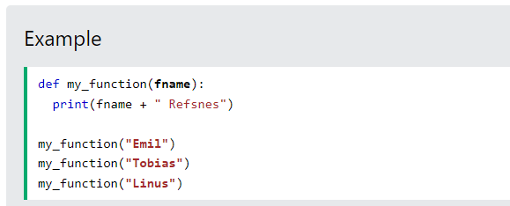
ARGUMENTS AND PARAMETERS
Arguments are specified after the function name, inside the parentheses. You can add as many arguments as you want, just separate them with a comma.

Slide 8
LAMBDA
Lambda functions have no name.
Multiple arguments and single expressions called lambda.
Lambda functions can take any number of arguments.
Lambda function can return just one value in the form of an expression.
It can not contain multiple expressions.
Lambda function can not access variables other than those in their parameter list.

Slide 9
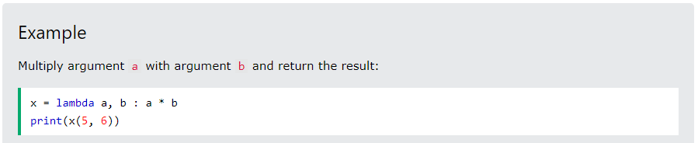
Syntax to write the lambda functions.
variable=lambda list of variables:expression .

Slide 10
DECORATORS
Wrapping one function in another function represented by @symbol
Functions that accept an object and return another to be used by the same name
Decorators are a way to modify or enhance functions without changing their code.

Slide 11
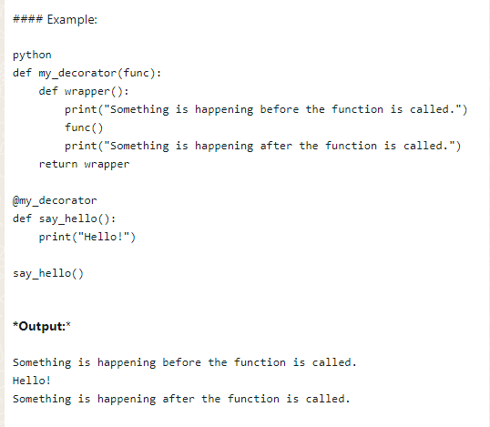
Example for Decorator:

Slide 12
GENERATORS
Python gererators lets you create your own iterator functions that return the traversal object with a sequence of values.
In a generator function,a yield statement is used rather than a return statement
The return statements terminates a function entirely while the yield statement pauses the function ,holding all its states and continuing on successive calls.

Slide 13
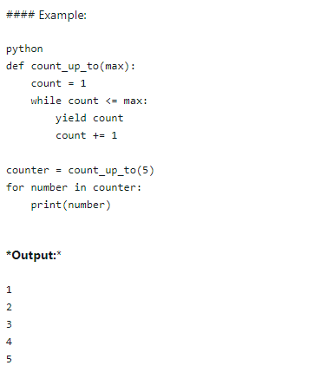
Example for Generators:

Slide 14
SUMMARY
*Functions:* Blocks of reusable code defined with def.-
*Lambda Functions:* Small, anonymous functions using lambda.-
*Decorators:* Modify functions using the @decorator syntax.-
*Generators:* Create iterators with yield for lazy evaluation.-
*Built-in Functions:* Predefined functions like sum, len, etc.-
*Modules:* Organize code into separate files and import them using import.

